Slide 1


Spin-based Neuromorphic Computing (Simulation)
Presented by: CHONG TIAN EN
Supervised by: S.N. Piramananyagam
Associate Professor
Division of PAP, SPMS
Co-supervised by: Mohamed M. Sabry
Assistant Professor
School of Computer Science and Engineering
27
th
April 2020

Slide 2

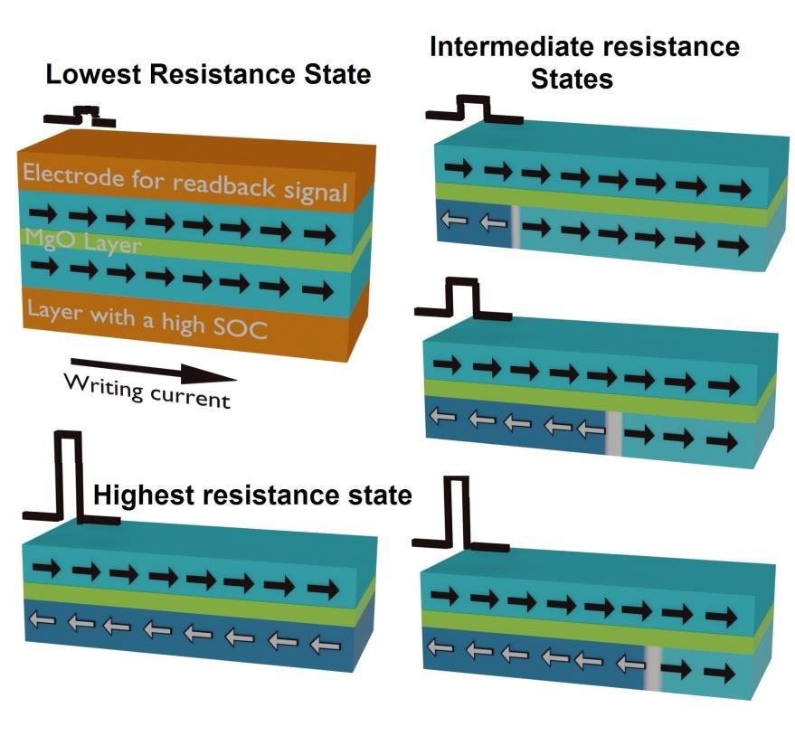
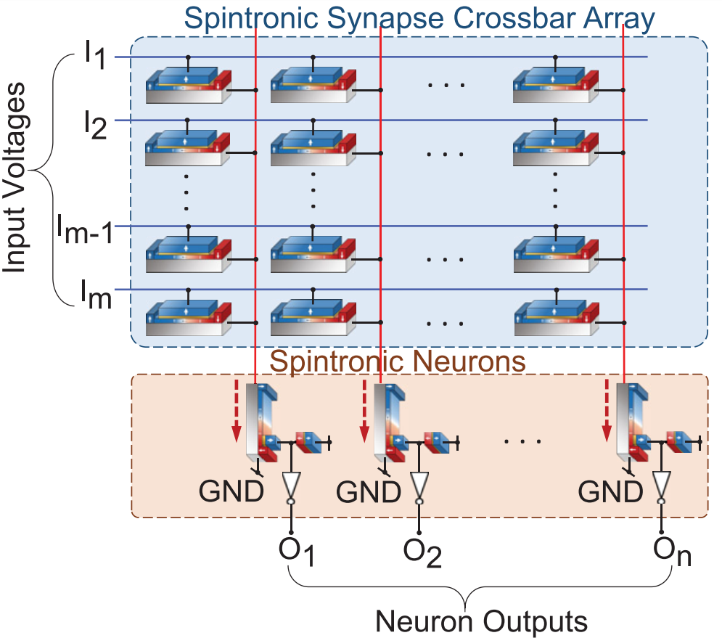
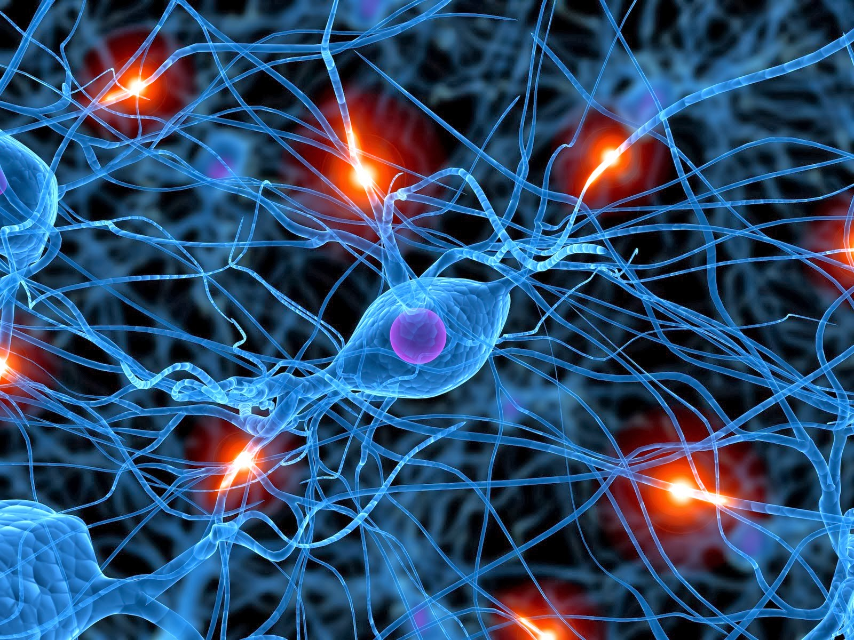
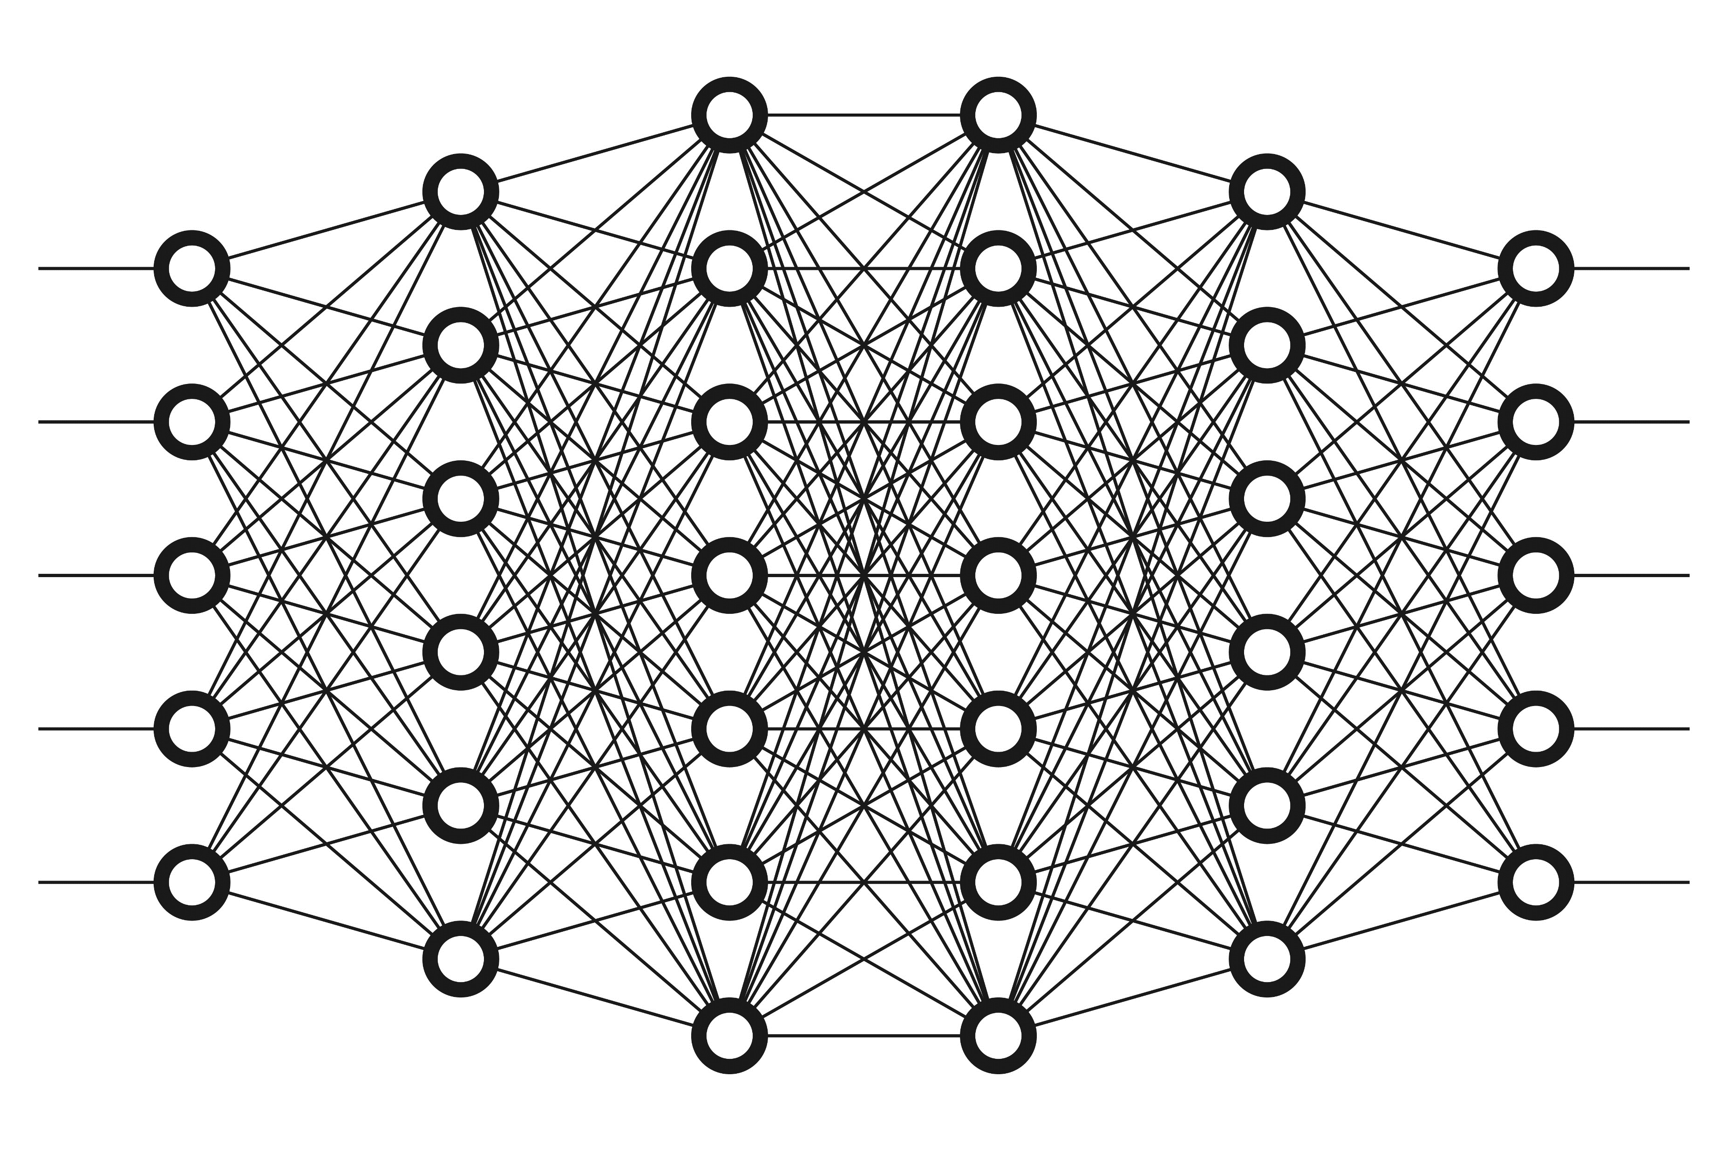

Introduction

Slide 3
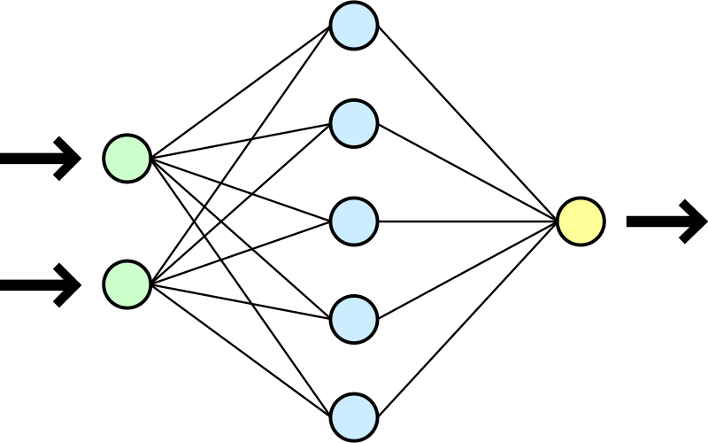

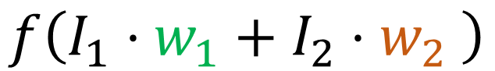
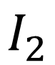
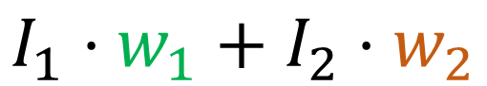
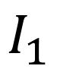
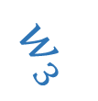
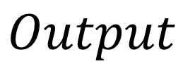
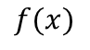

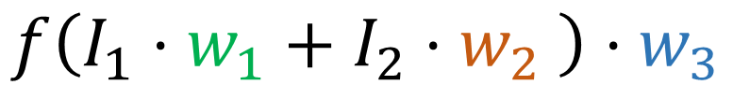
Neural Network
$$I_{1}⋅w_{1}+I_{2}⋅w_{2}$$
$$f\left(I_{1}⋅w_{1}+I_{2}⋅w_{2} \right)$$
$$f(x)$$
$$w_{1}$$
$$w_{2}$$
$$w_{3}$$
$$f\left(I_{1}⋅w_{1}+I_{2}⋅w_{2} \right)⋅w_{3}$$
$$I_{1}$$
$$Output$$
$$I_{2}$$

Slide 4
Neuromorphic Computing
Hardware based implementation of neural network
Application-Specific Integrated Circuit (ASIC)
Not for General Purpose Computing (Forget YouTube, Email, … etc)

Slide 5

Why Neuromorphic Computing?
Huge application in AI Computer Vision
Mimic human brain neuron and synapse network
Very efficient for visual object recognition
Low power consumption
Deeper layer network can extract subtler visual details
Network output can be fed for image classification

Slide 6
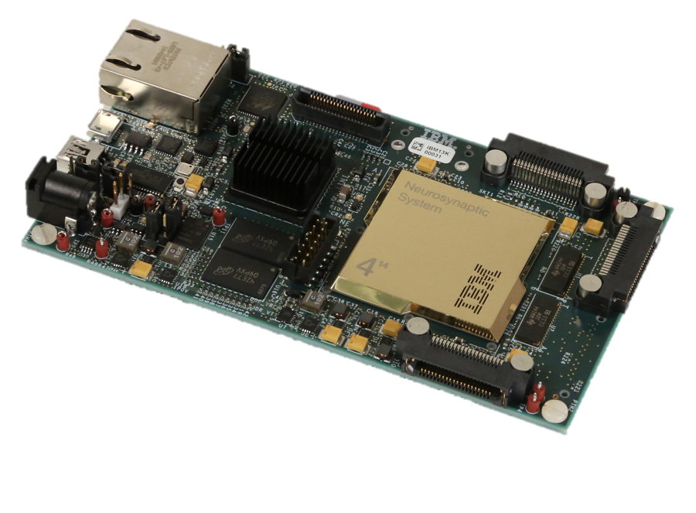
IBM TrueNorth Chip
4096 cores
256 neurons/core
256 synapses/neuron
Only consumes 63mW vs 500W desktop
(Neuromorphic Hardware: Trying to Put Brain Into Chips 2020)

Slide 7
Motivation (Use of Spintronics)
Originally used in hard disk drive read/write head
Involve in:
Spin Transfer Torque(STT)
Spin Orbit Torque (SOT)
Tunneling Magnetoresistance (TMR)
Giant Magnetoresistance (GMR)
for magnetoresistive application like Magnetoresistive Random-access Memory (MRAM)

Slide 8
Motivation (Use of Spintronics)
Non-volatile (information retention during power loss) like Solid State Drive (SSD) unlike Metal Oxide Semiconductor (MOS) and Capacitors
Similar to SSD, Magnetic Tunnel Junction (MTJ) uses electron tunnelling
MTJ has smaller footprint to CMOS (Main reason)
But, MTJ uses electron spin orientation instead of electron presence in SSD (charge retention changes threshold voltage, causing wear out)

Slide 9
Spintronics Advantage vs Conventional SSD
Higher read/write speed
Lower power
No wear out (Unlimited read/write cycle)
(What is MRAM | MagnetoResistive Memory Technology | Electronics Notes 2020)

Slide 10
Objective
To create and simulate model of neuromorphic network, incorporated with 8-step domain wall MRAM resistance based synapses and compare the performance between neuromorphic model and traditional software implemented neural network model.

Slide 11
Simulation Details (Outline)
Theory:
Inverting Summing Operational Amplifier (OpAmp)
Synaptic Weight
Weight→Resistance
Matrix Implementation
Actual Simulation Environment:
Cadence Development Environment with 65nm Process Design Kit (PDK)
Code Files
Programmable Scalable Network (Generated)

Slide 12
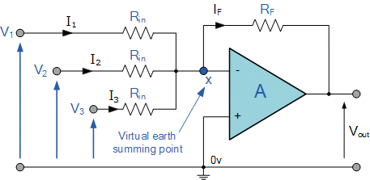
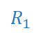
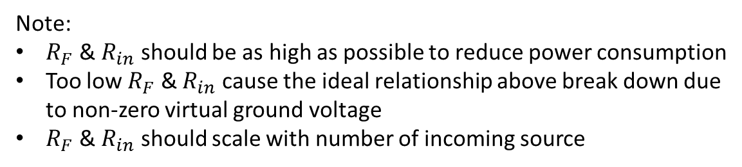
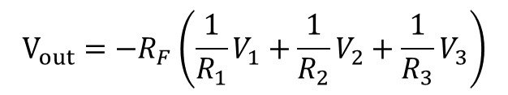
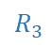
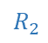
Inverting Summing OpAmp
$$R_{1}$$
$$R_{2}$$
$$R_{3}$$
Ideally,
$$V_{out}={−R}_{F}\left(\frac{1}{R_{1}}V_{1}+\frac{1}{R_{2}}V_{2}+\frac{1}{R_{3}}V_{3}\right)$$
Note:
$R_{F}$ & $R_{in}$ should be as high as possible to reduce power consumption
Too low $R_{F}$ & $R_{in}$ cause the ideal relationship above break down due to non-zero virtual ground voltage
$R_{F}$ & $R_{in}$ should scale with number of incoming source

Slide 13
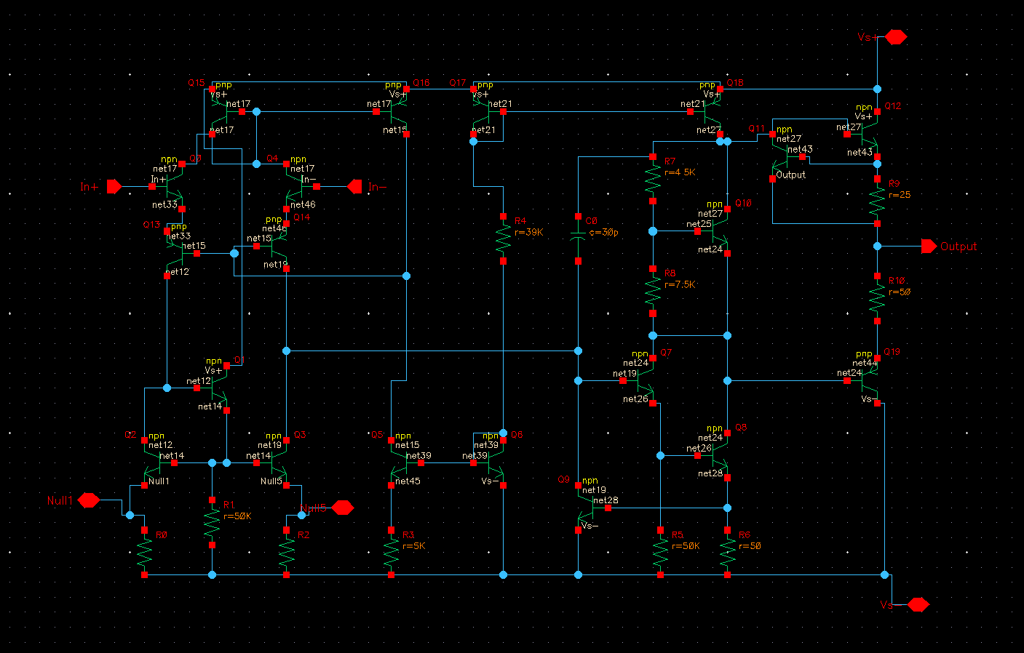
Tuned 741 Texas Instrument OpAmp Model

Slide 14
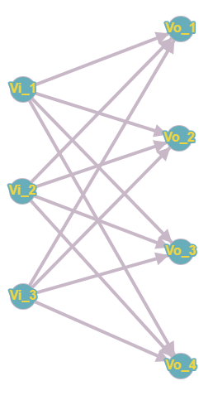
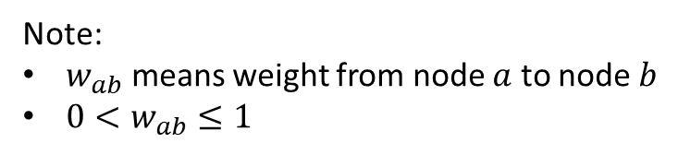
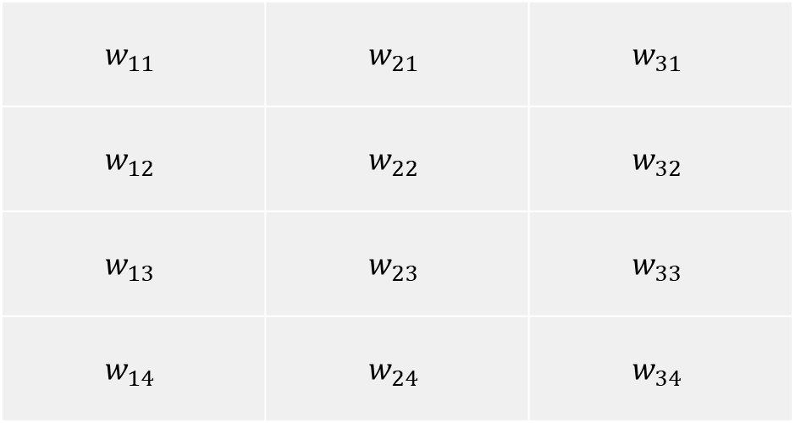
Synaptic Weight
$$w_{11}$$ | $$w_{21}$$ | $$w_{31}$$
$$w_{12}$$ | $$w_{22}$$ | $$w_{32}$$
$$w_{13}$$ | $$w_{23}$$ | $$w_{33}$$
$$w_{14}$$ | $$w_{24}$$ | $$w_{34}$$
Note:
$w_{ab}$ means weight from node $a$ to node $b$
$0<w_{ab}≤1$

Slide 15
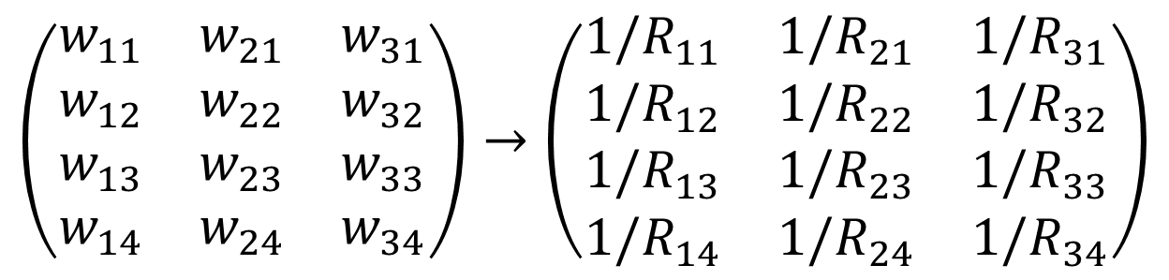
Weight $→$ Resistance
$$\left(\begin{matrix}w_{11} & w_{21} & w_{31} \\ w_{12} & w_{22} & w_{32} \\ w_{13} & w_{23} & w_{33} \\ w_{14} & w_{24} & w_{34}\end{matrix}\right)→\left(\begin{matrix}{1/R}_{11} & {1/R}_{21} & {1/R}_{31} \\ {1/R}_{12} & {1/R}_{22} & {1/R}_{32} \\ {1/R}_{13} & {1/R}_{23} & {1/R}_{33} \\ {1/R}_{14} & {1/R}_{24} & {1/R}_{34}\end{matrix}\right)$$
$$R=1/w$$

Slide 16
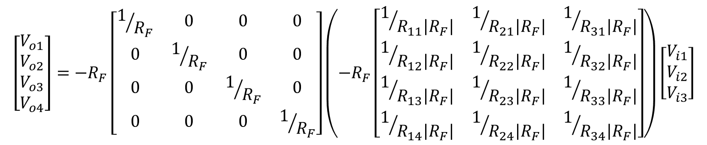
Matrix Implementation
$$\left[\begin{matrix}V_{o1} \\ V_{o2} \\ V_{o3} \\ V_{o4}\end{matrix}\right]=−R_{F}\left[\begin{matrix}1/{R_{F}} & 0 & 0 & 0 \\ 0 & 1/{R_{F}} & 0 & 0 \\ 0 & 0 & 1/{R_{F}} & 0 \\ 0 & 0 & 0 & 1/{R_{F}}\end{matrix}\right]\left(−R_{F}\left[\begin{matrix}1/{R_{11}\left|R_{F}\right|} & 1/{R_{21}\left|R_{F}\right|} & 1/{R_{31}\left|R_{F}\right|} \\ 1/{R_{12}\left|R_{F}\right|} & 1/{R_{22}\left|R_{F}\right|} & 1/{R_{32}\left|R_{F}\right|} \\ 1/{R_{13}\left|R_{F}\right|} & 1/{R_{23}\left|R_{F}\right|} & 1/{R_{33}\left|R_{F}\right|} \\ 1/{R_{14}\left|R_{F}\right|} & 1/{R_{24}\left|R_{F}\right|} & 1/{R_{34}\left|R_{F}\right|}\end{matrix}\right]\right)\left[\begin{matrix}V_{i1} \\ V_{i2} \\ V_{i3}\end{matrix}\right]$$

Slide 17
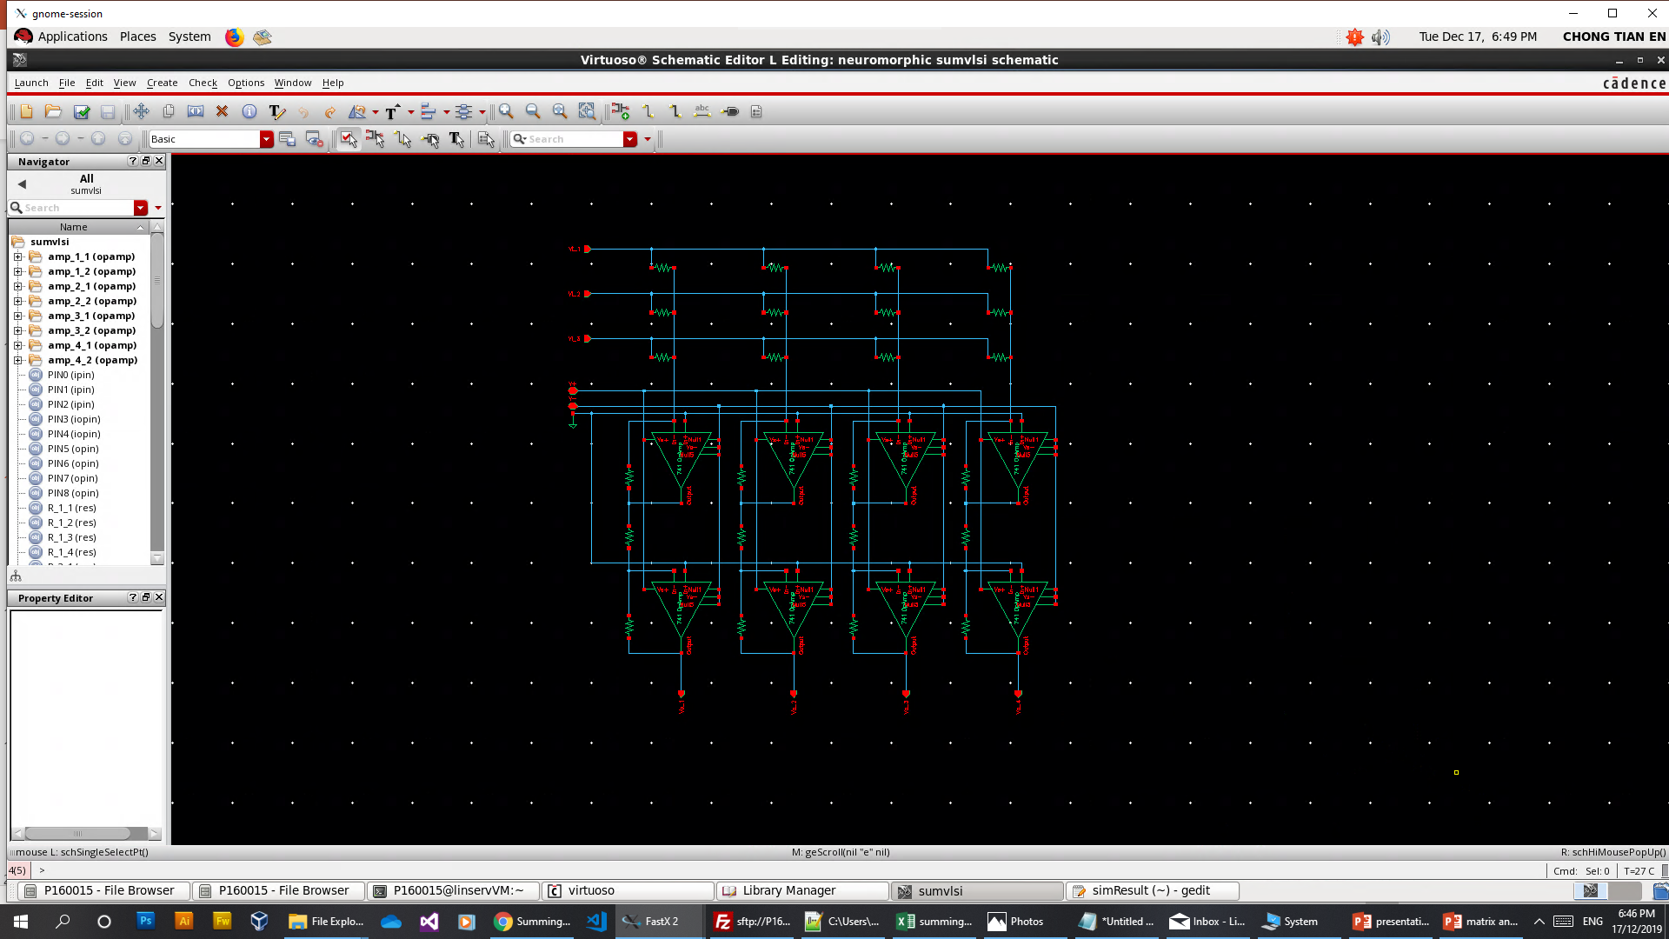
Cadence Development Environment with 65nm PDK

Slide 18
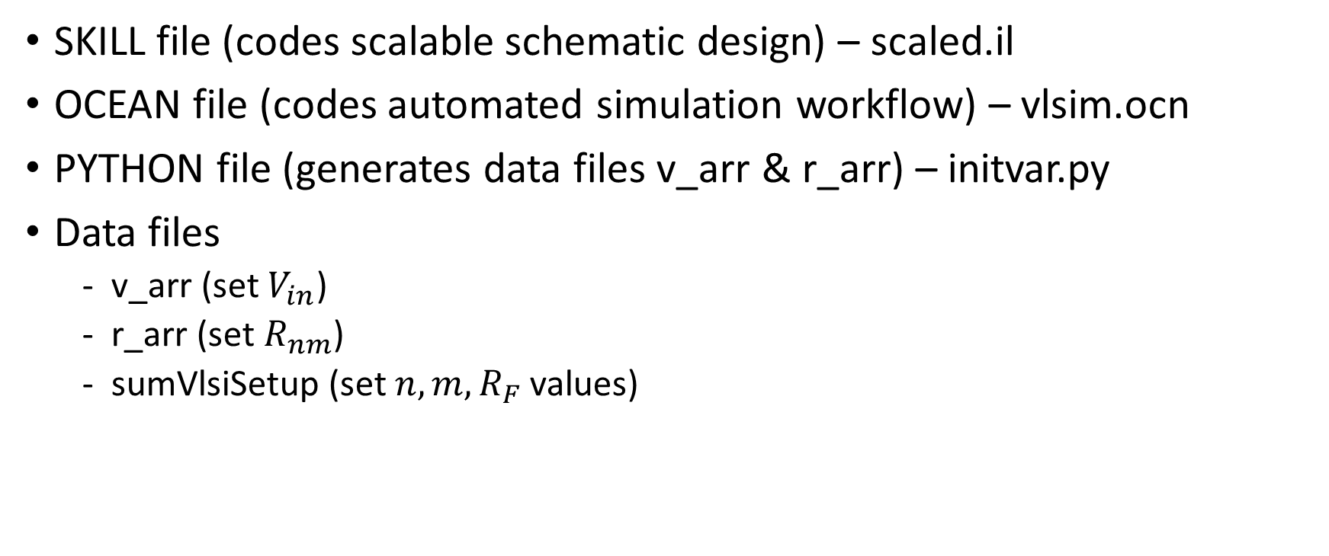
Code Files
SKILL file (codes scalable schematic design) – scaled.il
OCEAN file (codes automated simulation workflow) – vlsim.ocn
PYTHON file (generates data files v_arr & r_arr) – initvar.py
Data files
v_arr (set $V_{in}$)
r_arr (set $R_{nm}$)
sumVlsiSetup (set $n,m,R_{F}$ values)

Slide 19
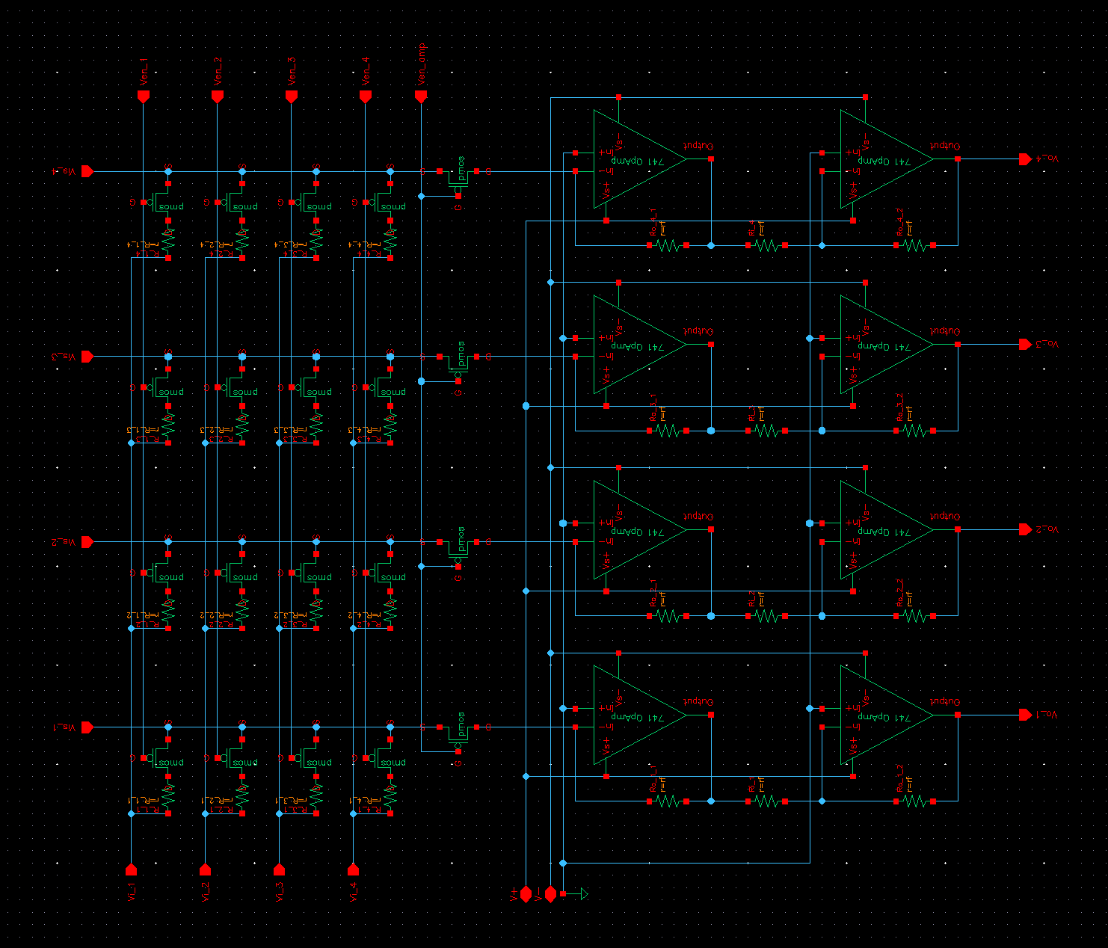
Programmable Scalable Network (Generated)
4 by 4 synapses
4 neurons

Slide 20
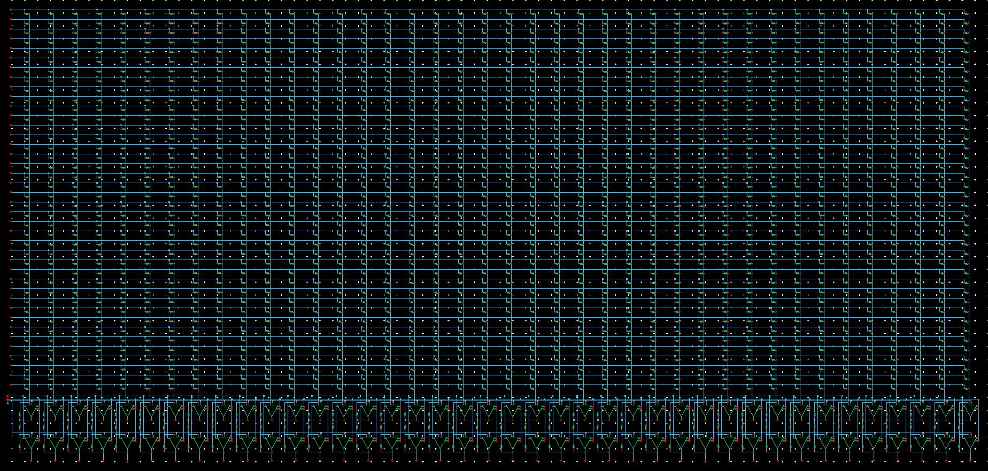
Programmable Scalable Network (Generated)
40 by 40 synapses, 40 neurons

Slide 21
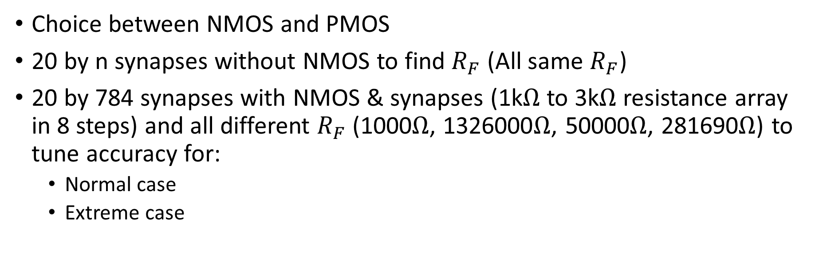
Pre-Simulation Result (Outline)
Choice between NMOS and PMOS
20 by n synapses without NMOS to find $R_{F}$ (All same $R_{F}$)
20 by 784 synapses with NMOS & synapses (1k$Ω$ to 3k$Ω$ resistance array in 8 steps) and all different $R_{F}$ (1000$Ω$, 1326000$Ω$, 50000$Ω$, 281690$Ω$) to tune accuracy for:
Normal case
Extreme case

Slide 22
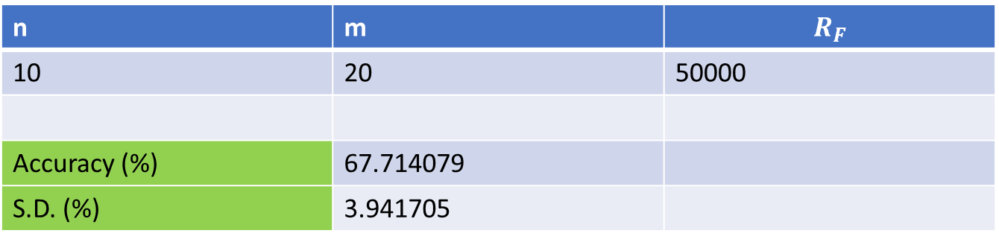

Choice between NMOS and PMOS
NMOS
n | m | $$R_{F}$$
10 | 20 | 50000
Accuracy (%) | 80.305877
S.D. (%) | 3.034855
PMOS
n | m | $$R_{F}$$
10 | 20 | 50000
Accuracy (%) | 67.714079
S.D. (%) | 3.941705

Slide 23
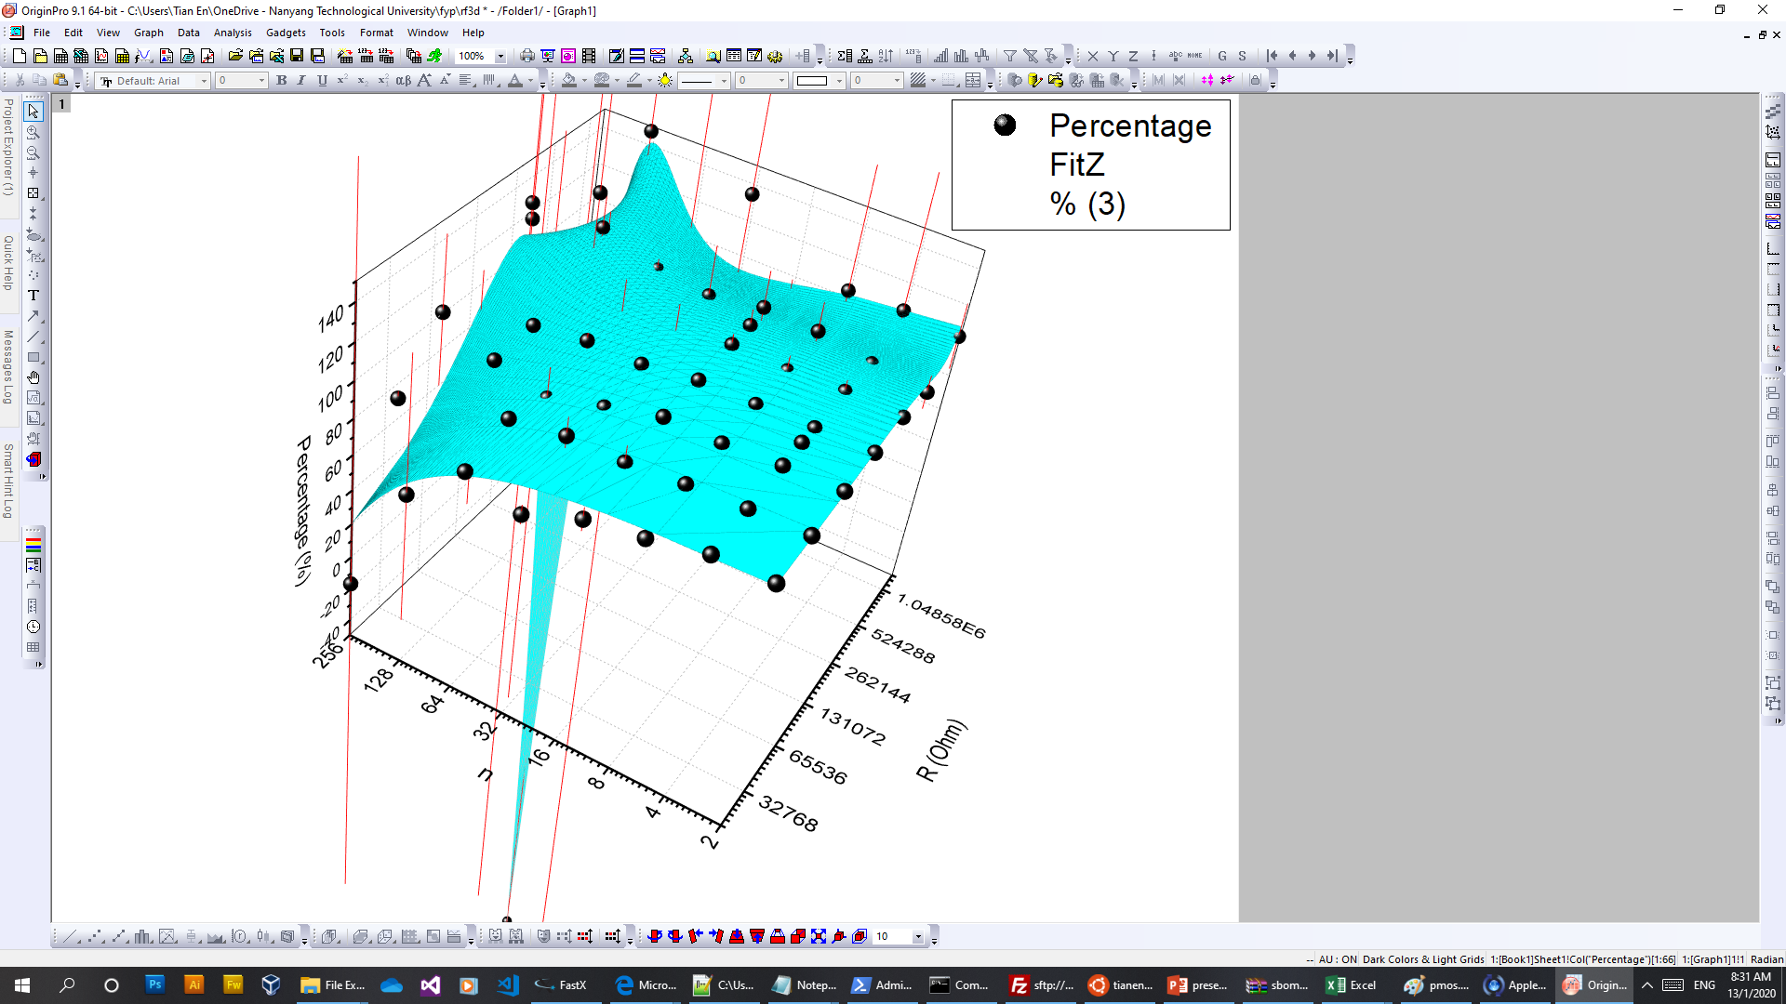
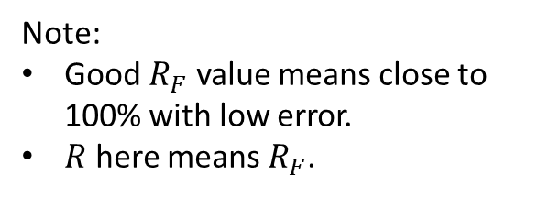
20 by n synapses without NMOS (determine $R_{F}$)
Note:
Good $R_{F}$ value means close to 100% with low error.
$R$ here means $R_{F}$.
Model xycube3 (User)
Equation a*(x^3)*(y^3)+b*(x^3)*(y^2)+c*(x^3)*y+d*(x^3)+e*(x^2)*(y^3)+f*(x^2)*(y^2)+g*(x^2)*y+h*(x^2)+i*x*(y^3)+j*x*(y^2)+k*x*y+l*x+m*(y^3)+n*(y^2)+o*y+p
Reduced Chi-Sqr 714.846761334228
Adj. R-Square 0.88555125529964
Value Standard Error
Percentage a -3.40118964147559E-23 4.44279966677437E-22
Percentage b -3.3808777225304E-17 8.2557808192898E-16
Percentage c -2.0259689587371E-12 3.61725948885066E-10
Percentage d 3.05421829039265E-7 3.11204579295629E-5
Percentage e 1.92465908629804E-20 1.64731730408421E-19
Percentage f -1.55450903885609E-14 3.06407421899329E-13
Percentage g 1.13182576777577E-8 1.34640724225518E-7
Percentage h -3.85131129416287E-4 0.0114965996521702
Percentage i -1.48264432713436E-18 1.4260049552801E-17
Percentage j 1.33599679889964E-12 2.65612549419855E-11
Percentage k -1.4137600682012E-7 1.1725381816539E-5
Percentage l -0.260480613981356 0.989939319105463
Percentage m 5.92946586687354E-17 2.14080692056229E-16
Percentage n -9.87499996805226E-11 3.98894294313358E-10
Percentage o 4.46259065749002E-5 1.76439168641693E-4
Percentage p 93.4097157841867 14.8960306390529

Slide 24
20 by 784 Synapses with NMOS & 8 steps R (Normal)
Simulated (V) | Ideal (V) | Closeness in Relation to Ideal (%)
2.700318 | 2.776228 | 97.265718
2.702225 | 2.747829 | 98.340354
2.732859 | 2.796039 | 97.740361
2.686072 | 2.730944 | 98.356926
2.660745 | 2.707836 | 98.260923
2.712146 | 2.804294 | 96.714057
2.681696 | 2.729543 | 98.247055
2.700021 | 2.803785 | 96.299133
2.711888 | 2.816474 | 96.286633
2.717287 | 2.81541 | 96.514803
2.706701 | 2.800897 | 96.636933
2.690087 | 2.775809 | 96.911833
2.705707 | 2.784995 | 97.153019
2.728542 | 2.842092 | 96.004721
2.705084 | 2.772916 | 97.553761
2.702902 | 2.774242 | 97.428462
2.693175 | 2.845671 | 94.641127
2.674825 | 2.720369 | 98.325793
2.70068 | 2.775882 | 97.290892
2.699092 | 2.77477 | 97.272615
Average (%) | 97.16226
S.D. (%) | 0.954687

Slide 25
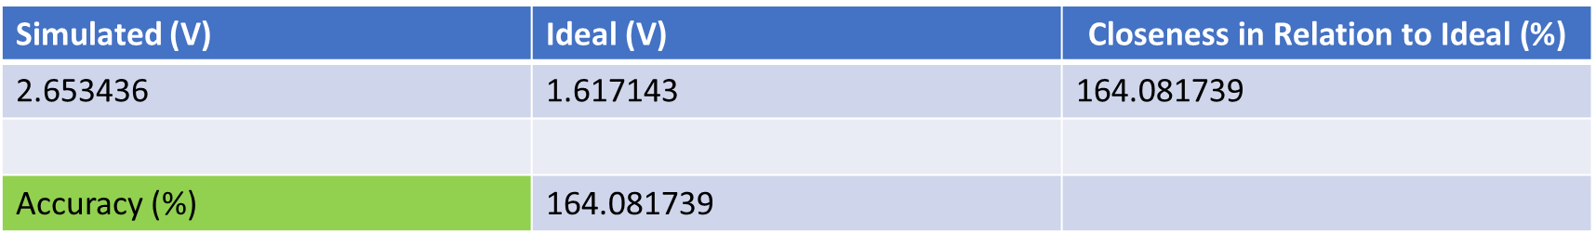
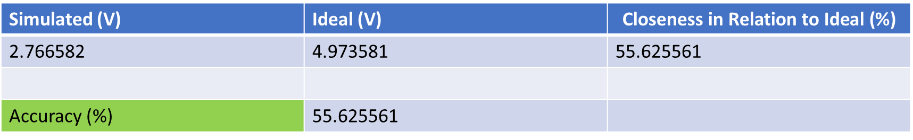
20 by 784 Synapses with NMOS & 8 steps R (Ex)
all R = 1000 (low R, high power consumption), same $R_{F}$s, same random V
Simulated (V) | Ideal (V) | $$\text{Closeness} \text{in} \text{Relation} \text{to} \text{Ideal}\text{ (\%)}$$
2.766582 | 4.973581 | 55.625561
Accuracy (%) | 55.625561
all R = 3000 (high R, low power consumption), same $R_{F}$s, same random V
Simulated (V) | Ideal (V) | $$\text{Closeness} \text{in} \text{Relation} \text{to} \text{Ideal}\text{ (\%)}$$
2.653436 | 1.617143 | 164.081739
Accuracy (%) | 164.081739
Notes:
Nebi Caka
Professor at University of Prishtina, Faculty of Electrical and Computer Engineering
In a semiconductor the mobility of electrons (referring to ‘conduction electrons’ or ‘free-electrons’) is greater than that of a holes (indirectly referring to ‘valence electrons’) because of different band structure and scattering mechanisms of these two carrier types.
Conduction electrons (free-electrons) travel in the conduction band and valence electrons (holes) travel in the valence band. In an applied electric field, valence electrons cannot move as freely as the free electrons because their movement is restricted. The mobility of a particle in a semiconductor is larger if its effective mass is smaller and the time between scattering events is larger.
Holes are created by the elevation of electrons from innermost shells to higher shells or shells with higher energy levels. Since holes are subjected to the stronger atomic force pulled by the nucleus than the electrons residing in the higher shells or farther shells, holes have a lower mobility.
In an intrinsic silicon, at temperature 300 K:
Electron mobility = 1500 cm2/(V∙s)
Hole mobility = 475 cm2/(V∙s)

Slide 26
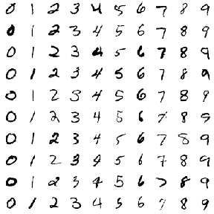



Auxiliary Simulation Details (Outline)
Tools of trade:
Tensorflow (Machine Learning Platform)
Keras (Python Deep Learning Library)
MNIST (Standard Handwritten Digit Dataset)
OpenCV (Computer vision and machine learning library)

Slide 27
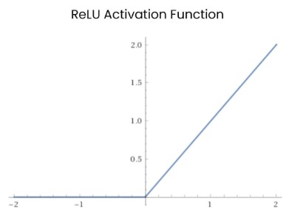
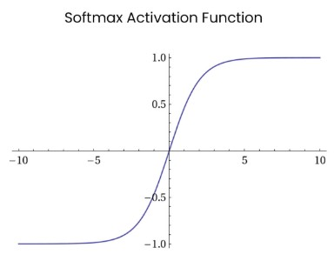
Auxiliary Simulation Result
Output
Input -> FCN 100 -> output
Accuracy : 11.78%
Input -> FCN 100 with ReLU activation -> output
Accuracy : 11.35%
Input -> FCN 100 with ReLU activation -> output with ReLU activation
Accuracy : 9.80%
Input -> FCN 100 with ReLU activation -> output with softmax activation
Accuracy : 96.91%
Input -> FCN 100 with softmax activation -> output with softmax activation
Accuracy : 54.97%
Input
Output
Input

Slide 28
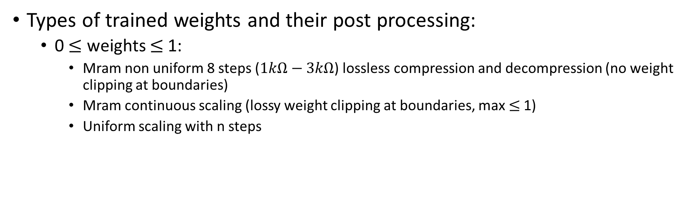
Auxiliary Simulation Result (Types of Weights)
Types of trained weights and their post processing:
0 $≤$ weights $≤$1:
Mram non uniform 8 steps ($1kΩ−3kΩ$) lossless compression and decompression (no weight clipping at boundaries)
Mram continuous scaling (lossy weight clipping at boundaries, max $≤$1)
Uniform scaling with n steps

Slide 29
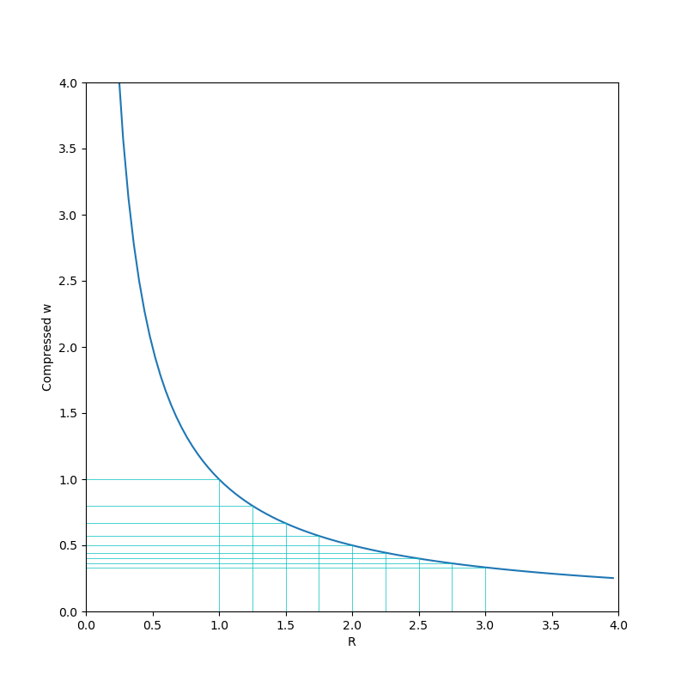
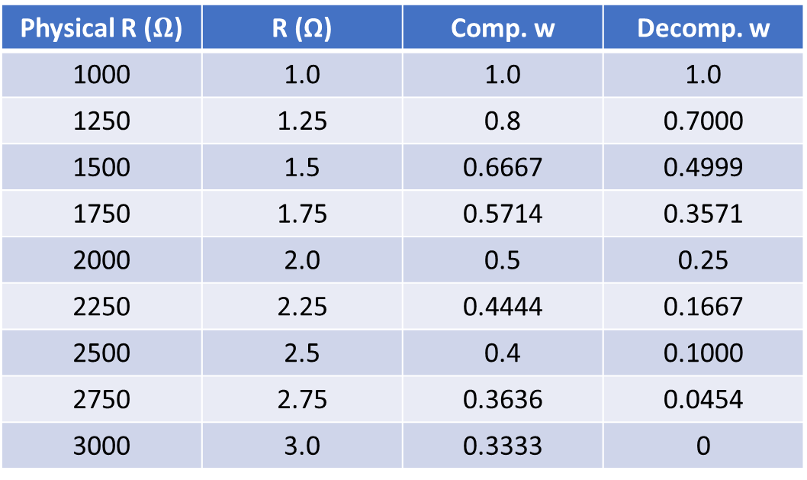
0$≤$weights$≤$1(Mram Lossless Com/decompression)
Physical R ($Ω$) | R (Ω) | Comp. w | Decomp. w
1000 | 1.0 | 1.0 | 1.0
1250 | 1.25 | 0.8 | 0.7000
1500 | 1.5 | 0.6667 | 0.4999
1750 | 1.75 | 0.5714 | 0.3571
2000 | 2.0 | 0.5 | 0.25
2250 | 2.25 | 0.4444 | 0.1667
2500 | 2.5 | 0.4 | 0.1000
2750 | 2.75 | 0.3636 | 0.0454
3000 | 3.0 | 0.3333 | 0

Slide 30
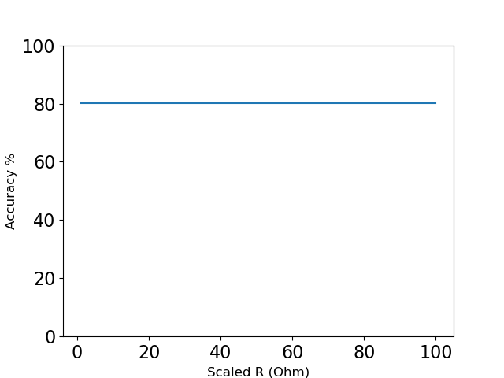
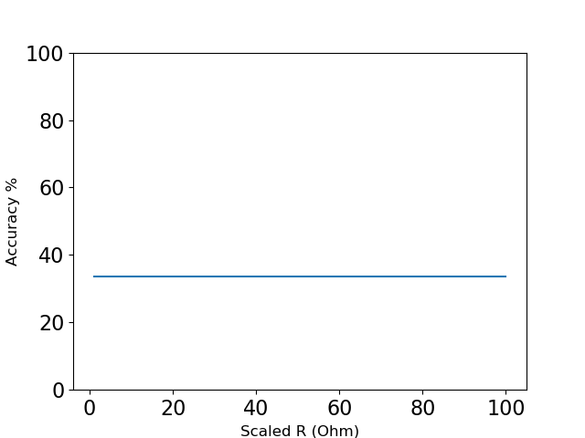
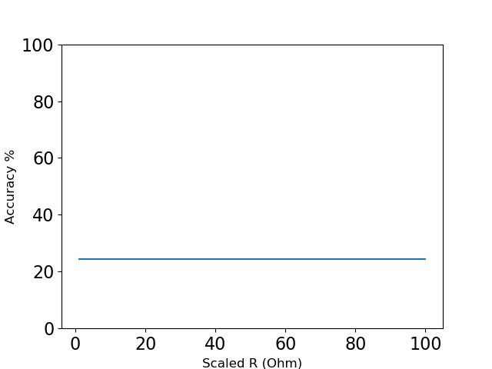
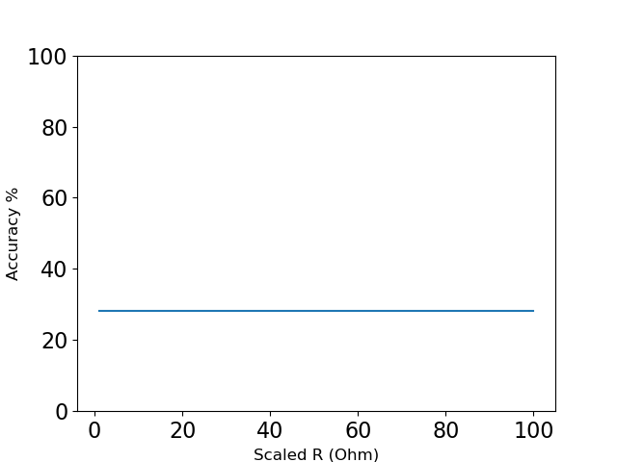
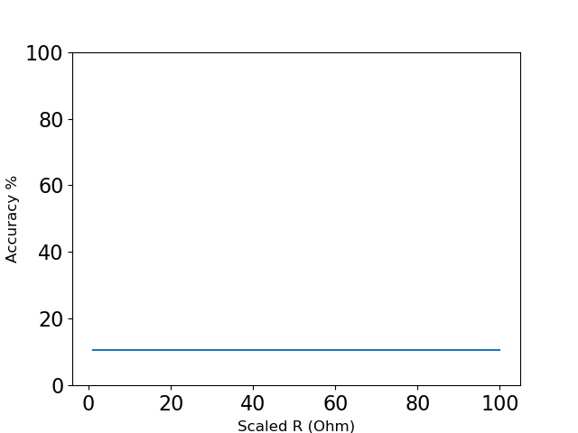
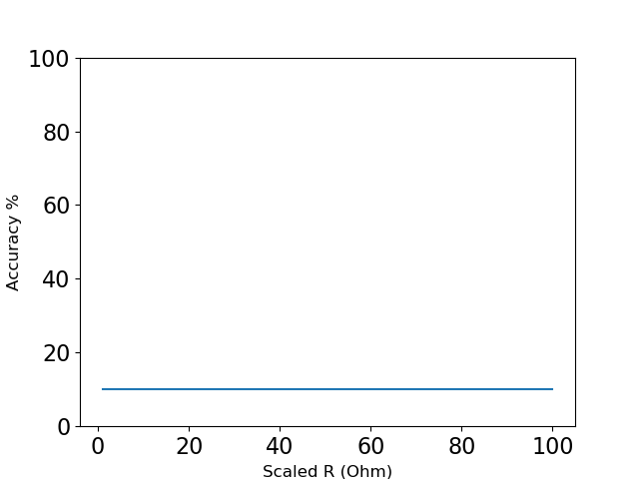
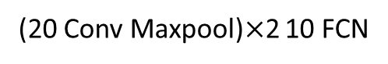
0$≤$weights$≤$1(Mram Lossless Com/decompression)
20 FCN
1000 FCN
20 Conv Maxpool 10 FCN
80.24%
100 Conv Maxpool 10 FCN
(20 Conv Maxpool)$×$2 10 FCN
20 Conv Maxpool 50 Conv Maxpool 10 FCN

Slide 31
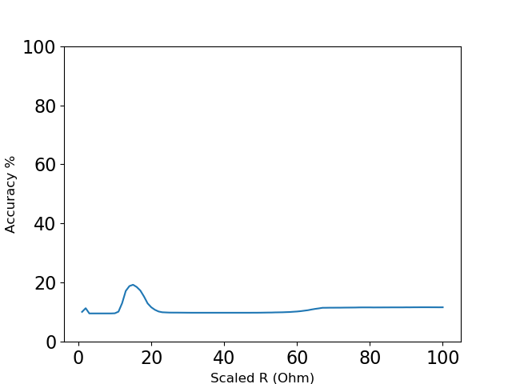





0$≤$weights$≤$1 (Mram continuous scaling)
20 FCN
1000 FCN
20 Conv Maxpool 10 FCN
100 Conv Maxpool 10 FCN
(20 Conv Maxpool)$×$2 10 FCN
20 Conv Maxpool 50 Conv Maxpool 10 FCN

Slide 32







0$≤$weights$≤$1(Uniform scaling with n steps)
)
20 FCN
1000 FCN
20 Conv Maxpool 10 FCN
100 Conv Maxpool 10 FCN
(20 Conv Maxpool)$×$2 10 FCN
20 Conv Maxpool 50 Conv Maxpool 10 FCN

Slide 33
Simulation Result (Neuromorphic Circuit)
$20×784$ Dense Layer
20×784 Dense Layer
$10×20$ Dense Layer
10×20 Dense Layer
Input
Output
Intermediate Output/Input

Slide 34
Simulation Result (10 by 20 Neuromorphic Circuit)
Outputs are measured and softmax function is applied (not implemented in circuit)
Location of maximum values are extracted to predict the 10000 MNIST test dataset samples

Slide 35

Simulation Result (10 by 20 Neuromorphic Circuit)
Accuracy | 81.02%
vs 80.24% (Surprisingly better with circuit errors!)

Slide 36
Simulation Result (20 by 784 Single Stage Summing)
Simulated | Ideal | Closeness in Relation to Ideal (%)
0.135432 | 0.184488 | 73.409689
0.135394 | 0.109829 | 123.276832
0.135418 | 0.153579 | 88.1746
0.135387 | 0.096275 | 140.62579
0.13537 | 0.052955 | 255.629231
0.135561 | 0.426084 | 31.815499
0.135418 | 0.139721 | 96.920202
0.135382 | 0.079832 | 169.58257
0.135395 | 0.114157 | 118.604769
0.135393 | 0.105954 | 127.785239
0.135411 | 0.141157 | 95.92926
0.135434 | 0.176834 | 76.587877
0.135518 | 0.344878 | 39.294377
0.135393 | 0.107198 | 126.301745
0.135438 | 0.187873 | 72.090304
0.135388 | 0.086403 | 156.69367
0.135426 | 0.171996 | 78.737742
0.135534 | 0.373579 | 36.279791
0.13555 | 0.405211 | 33.451767
0.135426 | 0.170786 | 79.29625
Average (%) | 101.02436
S.D. (%) | 54.367929
S.D. = 53.8% (after scaling average to 100%)

Slide 37
Simulation Result (20 by 784 Double Stage Summing)
Simulated | Ideal | Closeness in Relation to Ideal (%)
0.119176 | 0.922442 | 12.919613
0.119235 | 0.549144 | 21.71278
0.119187 | 0.767897 | 15.521187
0.119324 | 0.481373 | 24.788231
0.11945 | 0.264777 | 45.113587
0.118708 | 2.130422 | 5.572057
0.119377 | 0.698604 | 17.087943
0.119312 | 0.399162 | 29.890524
0.119323 | 0.570784 | 20.905103
0.119224 | 0.529768 | 22.504849
0.119346 | 0.705787 | 16.90957
0.119134 | 0.884171 | 13.47411
0.119039 | 1.724391 | 6.903221
0.119261 | 0.535989 | 22.250565
0.118996 | 0.939364 | 12.667756
0.119406 | 0.432014 | 27.639422
0.119123 | 0.859982 | 13.851773
0.119 | 1.867897 | 6.370776
0.118785 | 2.026055 | 5.862879
0.119097 | 0.853928 | 13.946989
Average (%) | 17.794647
S.D. (%) | 9.602465
S.D. = 54.0% (after scaling average to 100%)

Slide 38

Discussion
Need to amplify the simulated value to achieve comparable ideal value to offset accuracy loss due to non-zero OpAmp virtual ground voltage.
Need to recalibrate $R_{F}$ with network of different scale to obtain high accuracy.
Deeper layer networks bring high ideal accuracy in Tensorflow, but create more errors for neuromorphic circuit.
Notes:
we need to strike a balance.
MRAM limited 8 steps weights rounding result in reduced accuracy due to not representing weights faithfully, which can be solved with higher steps weight representation.

Slide 39
Conclusion
Neuromorphic computing offers high accuracy for off-chip training TensorFlow architecture
Suffers scaling issues due to non-ideal OpAmp behaviour and MRAM limited step weight representation

Slide 40
Future Work

Slide 41
Thank you!

